Slide 1

The JJJ Marketing is a company that promoting, selling and distributing products to our potential Customers and Clients.
Because we want to promote our products to our clients and to establish leadership

Slide 2
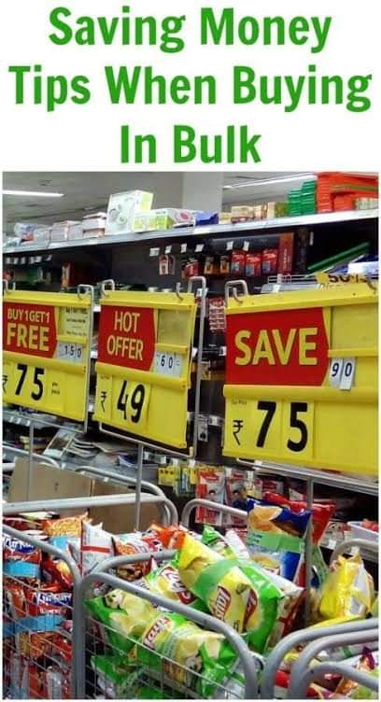
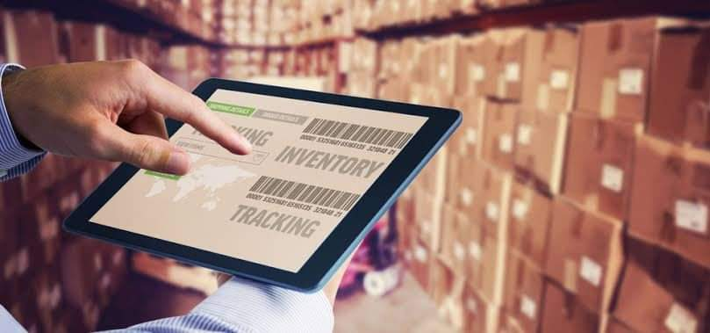

-+
PROS
You can take advantage of bulk savings
Suppliers will offer plenty of savings if you buy
in bulk and this can definitely be worthwhile to your
business if you map out the inventory you will need.
You’ll never fully know how much stock you will need,
but if you do end up with too much, then you can always run
a promotional sale on the left over inventory and attract new customers.
You can manage how much stock you’ll need
If you’re running low on stock then you can order more, just in case. Plus you’ll come to learn when stock will be in high demand, especially if you are running a promotion.
You can provide better customer service
If you have fully access to your inventory then it allows you to provide better customer service because you’re cutting out the middle man.
If your customers come to you with a rush order then you can reduce the time they have to wait by sending it out straight away.

Slide 3



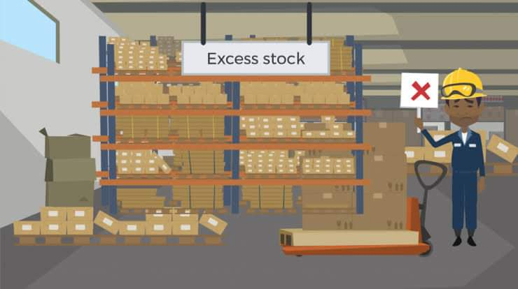
-+
CONS
You need space for
Your products
Your inventory could
become outdated
J
J
J
Although buying in bulk is great for saving you money, if you have only just set up your store then you may not have the money to buy stock until a customer makes an order
If you can’t afford to buy products in bulk then it is worth using drop shipping until you have made enough money to keep the stock at your business
One of the biggest set backs is that you will need enough room to store your products. More often than not you will have to invest in storage space which can be quite pricey.
This can also incur costs to maintain and run, which means you’ll have to put your prices up on your products and you could end up losing out in the long run.
As you will need to buy in bulk there’s always the risk that you won’t shift all of your stock and it could become outdated.

Slide 4

CONS
More work is involved
You’ll have to pay insurance
Taking care of your own stock definitely requires more work on your part. Not only do you need the space for it, but you need to keep track of how much you’ll need in future and keep full control of deliveries.
The great thing about running an online store is that you can do it from anywhere, but this isn’t really possible if you have to manage the delivery side of your orders too.
Probably not something that you may have thought of, but it’s one of the unfortunate facts of life. If you have all you stock at your head quarters then you are going to have to pay higher insurance premiums.
You’re risking the chance of loss, theft, or even fire/water damage to your stock and if this happens then you will lose out on sales, and quite possibly loyal customers.

Slide 5
The scope of an sales and inventory system can cover many needs, including valuing the inventory, measuring the change in inventory and planning for future inventory levels. The value of an inventory system can cover many needs, including valuing the inventory, measuring the change in inventory and planning for future inventory levels. The value of the inventory at the end of each period provides a basis for financial reporting on the balance sheet. Measuring the change in Inventory allows the company to determine the cost of inventory sold during the period. This allows the company to plan for future inventory needs
The Limitations of sales and inventory system include not knowing an exact inventory count in the middle of the period and running the risk of stockouts. With the periodic system, the company know the inventory level with certainty only when it physically counts the inventory at the end of each period. Throughout the period, the company takes customer orders without knowing the exact inventory count or whether enough products are available to meet customer demand.
The limitations of perpetual inventory system include false sense of reliability and dependence on human entry. Although a perpetual system updates each time a transaction enters the system, it might lack information regarding stolen, damaged or scrapped units. The company remains unaware of the theft or waste, known as shrinkage, until it performs a physical count at least once per year . The other limitation is than an employee might enter data incorrectly, introducing inaccurate information that can compromise decision-making
SCOPE
LIMITATIONS

Slide 6

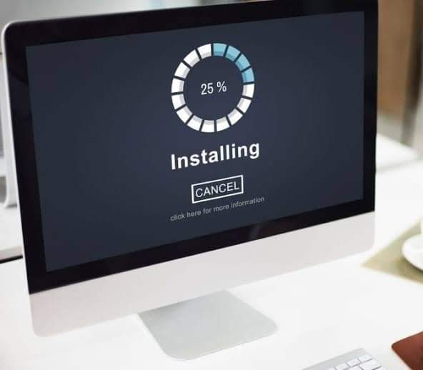


Installation

Slide 7


Client Overview
Satisfied customers inventory management software ensures that all customer orders are fulfilled properly through real time information related to your inventory levels. The system also allows you to track the shipments until they’re received by customer’s. So that in the end, this system help increase customer satisfaction with your services.

Slide 8
Admin Overview
An sales and inventory manage system keeps your company away from financial losses due to human errors, excessive stock storage, unnecessary purchases, late deliveries, and so on. With a centralized and integrated system, you don’t need to spend extra money on additional systems to manage your inventory. You can also reduce the costs you might need to pay an inventory specialist, since the inventory management system is able to automate most of the inventory operations. Besides, it can be easily implemented by anyone even if they have no experience in inventory control.
.

Slide 9

Inventory is the most valuable asset in large number of small businesses, and it can also be one of the most difficult assets to keep under control. Theft, administrative errors, physical damage and obsolescence all eat away at inventory, squeezing profit margins and damaging bottom lines.
Data Security and Credibility
Implement policies to limit the amount of people with access to your inventory, and keep a record of who has access to secure areas at specific times throughout each day.
Implement fool-proof system for inventory receipt and storage. Section off designated areas for each inventory item; clearly label each section and train new employees on the storage area’s layout. Create user-friendly checklists and verification procedure’s for employees receiving or making shipments of inventory.
Create a plan to take advantage to central warehousing and cooperative purchasing techniques. Create a formal system to replenish inventory at one location with excess inventory from another location, when possible, and to combine purchases for several locations into a single purchase order. This can help you to make fewer and larger purchases, allowing you to take advantage of quantity discounts and minimize distribution costs across the supply chain.

Slide 10

Estimate demand for each stock item annually. Create demand schedules covering each quarter or month in the coming year. Take seasonal demand fluctuations into account and plan to stock up on seasonal inventory items clearly. Established companies can use previous years sales figures as a starting point when estimating demand; new business may have to rely on competitor’s pas revenue figures and managements expectations for first year market share. Use these estimates to calculate the ideal re-order points and maximum stock levels for each stock item.
Data Security and Credibility
Create database of all stock items. For each stock item, include information on the item’s cost, suppliers, current stock level, lead time and inventory classification.
Create a notification system to alert employees when an inventory item’s re-order point or maximum stock level has been reached. Determine the point at which the system trigger a notification by taking the item’s lead time and recent demand into consideration.
Establish policies that ensure the timely processing of all paperwork, including purchase orders, receipts and inventory counts as quickly as possible to ensure your records are continually accurate. Establish a manual or computer-aided process to update your stock database at least daily, covering all inventory receipts, sales and transfer.

